Slide 1
System Context Diagram
Book Owners
Book Renters
Input books, offer books for rent, manage books rented out
View books to rent, rent books, manage books rented
Book Rental System

Slide 2
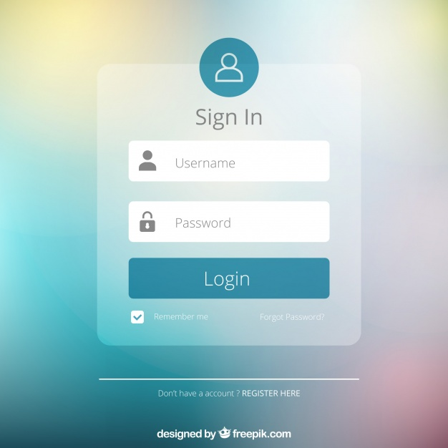
Book Owners
Context Diagram
Book Renters
Login API
HTTPS
HTTPS
User ID
Book Retrieval System
Book Entry System
Web Server
Book info, user data
Book info, user data
Book info
Book info
Data Store

Slide 3
Entities
Entities encapsulate enterprise-wide Critical Business Rules. An entity can be an object with methods, or it can be a set of data structures and functions. It doesn’t matter so long as the entities can be used by many different applications in the enterprise, amd support critical business functions independent of any specific technology.(Page 197)
Entities from use case 1,5 7
Books
ISBN Number Author Title Version
+isbnSearch +titleSearch +authorSearch
BookRentalTerm
ISBN Title Rental Term Book Owner Fn + Ln Rental status Rental Charges
+Owner_isbnSearch +Owner_titleSearch +Owner_calcRentalTerm

Slide 4
UI layer:
Applying the rule of Dependency, the business entities will be used by the use case to control the UI gateway access for output and input to the UI.
Entities
Business rules/
use case
Database gateway
UI gateway Access for
use case input
UI gateway Access for
use case output
UI Access

Slide 5
Database layer:
Applying the rule of Dependency, the Business Rules will use the Database gateway class to load and save data. The DataAccess will implement the I DB gateway interface and direct the operation of the database. Any changes to the DB structure should never impact the database, however changes to the business rule should impact the database.
Business Rules
Database gateway
Database Access
Database: MySQL

Slide 6
Monitoring & Logging layer:
Applying the rule of Dependency, the business log requirements will be used by the logging system to control the logging system interface which access the input from the system to be logged using the systems gateway for output.
Logging requirements
Logging System
Logging Interface
Systems gateway
Systems
Logging output

